Slide 1

7th Grade Math
Unit 3, Lesson 1 Adding Rational Numbers Volume 1, pg. 85

Slide 2


Benchmark
MA.7.NSO.2.2
Add, subtract, multiply, and divide rational numbers with procedural fluency.
volume 1, pg. 85

Slide 3
Integrated Mathematical Thinking and Reasoning Standards
MA.K12.MTR.1.1 Actively participate in effortful learning both individually and collectively.
MA.K12.MTR.2.1 Demonstrate understanding by representing problems in multiple ways.
MA.K12.MTR.3.1 Complete tasks with mathematical fluency.
MA.K12.MTR.4.1 Engage in discussions that reflect on the mathematical thinking of self and others.
MA.K12.MTR.5.1 Use patterns and structure to help understand and connect mathematical concepts.
volume 1, pg. 85

Slide 4

Learning Target
I can fluently add rational numbers.
volume 1, pg. 85

Slide 5

Warm-Up
volume 1, pg. 85

Slide 6
3.1.1 Warm-Up: Landscape Architect
Janice Nicol, a landscape architect, works to design natural systems and outdoor spaces, like trails and parks, for campuses and recreational facilities. Her job is both creative and technical. Creativity is expressed through drawing sketches both by hand and by using computer design programs and imaging. The technical side of her job involves knowing things such as land grading, water calculations, and natural systems.
Janice mentions that she regularly collaborates and works together with others while doing her job.
volume 1, pg. 85
Notes:
Video Link: https://algebranation.wistia.com/medias/fi4fidi5y8

Slide 7
Why do you think it is important to be able to collaborate when doing a job?
How can you build your collaboration skills?
volume 1, pg. 85
Notes:
Video Link: https://algebranation.wistia.com/medias/fi4fidi5y8

Slide 8

Guided Instruction
volume 1, pg. 86

Slide 9


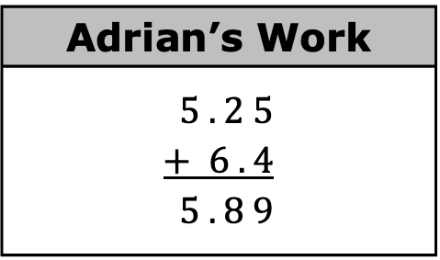
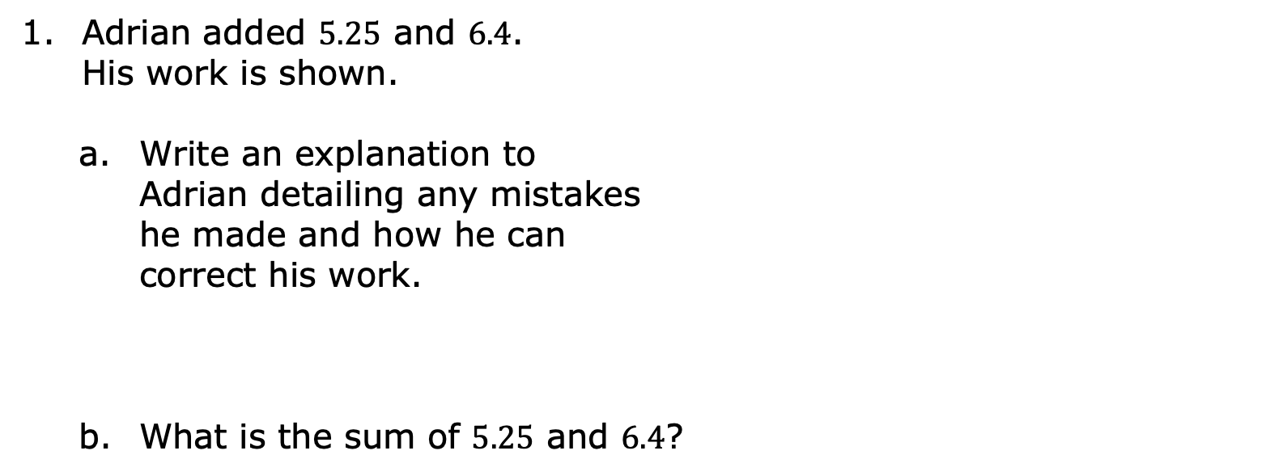
3.1.2 Guided Instruction: Adding Positive Rational Numbers
Adrian added $5.25$ and $6.4$. His work is shown.
Write an explanation to Adrian detailing any mistakes he made and how he can correct his work.
What is the sum of $5.25$ and $6.4$?
Adrian’s Work
$$5 . 2 5$$ $$+ 6 . 4$$ $$5 . 8 9$$
When finding the sum of decimal numbers, add values with the same place value.
volume 1, pg. 86

Slide 10
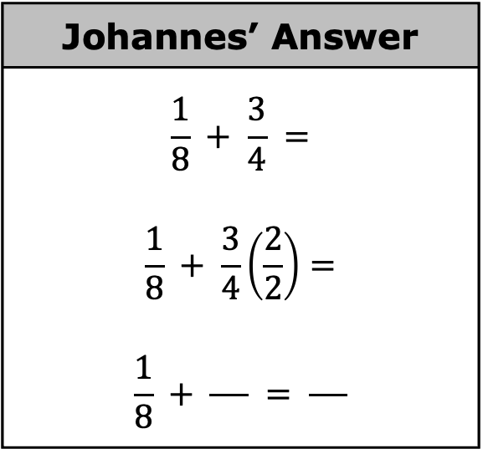
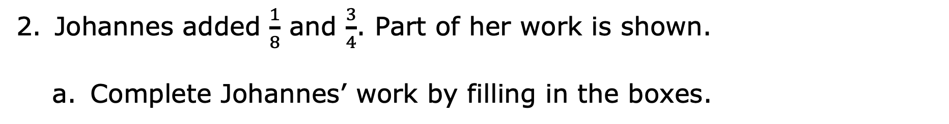
Johannes added $\frac{1}{8}$ and $\frac{3}{4}$. Part of her work is shown.
Complete Johannes’ work by filling in the boxes.
Johannes’ Answer
$$\frac{1}{8} + \frac{3}{4} =$$ $$\frac{1}{8} + \frac{3}{4}\left(\frac{2}{2}\right)=$$ $$\frac{1}{8} + \frac{ }{ } = \frac{ }{ }$$
volume 1, pg. 86

Slide 11
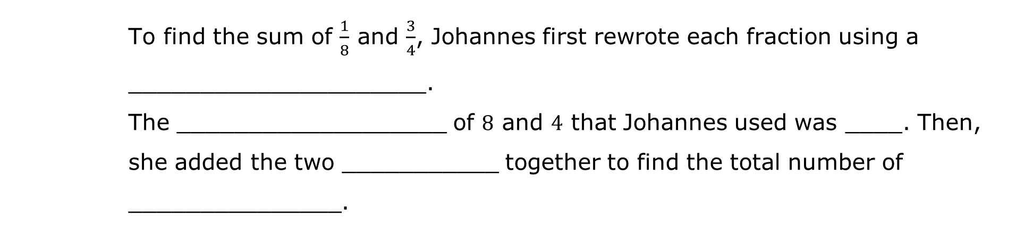
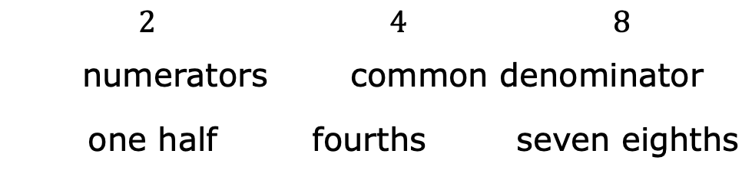
Complete the statements by choosing a word or number from the bank. Not all words and numbers may be used, and some may be used more than once.
Word Bank
$$2$$ | $$4$$ | $$8$$
numerators | common denominator
one half | fourths | seven eighths
To find the sum of $\frac{1}{8}$ and $\frac{3}{4}$, Johannes first rewrote each fraction using a _____________________.
The ___________________ of $8$ and $4$ that Johannes used was ____. Then, she added the two ___________ together to find the total number of _______________.
volume 1, pg. 86

Slide 12

Try It
volume 1, pg. 87

Slide 13
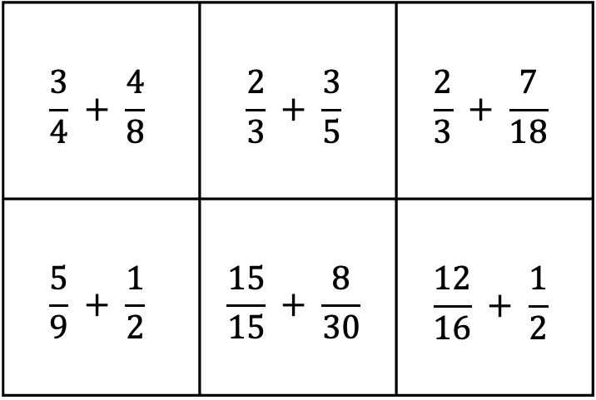
3.1.3 Try It: Adding Positive Rational Numbers
Match pairs of expressions that have the same sum. Write the equivalent expressions on the lines provided.
$$\frac{3}{4} + \frac{4}{8}$$ | $$\frac{2}{3} + \frac{3}{5}$$ | $$\frac{2}{3} + \frac{7}{18}$$
$$\frac{5}{9} + \frac{1}{2}$$ | $$\frac{15}{15} + \frac{8}{30}$$ | $$\frac{12}{16} + \frac{1}{2}$$
_________ = _________
_________ = _________
_________ = _________
volume 1, pg. 87

Slide 14

Refresher
volume 1, pg. 87

Slide 15

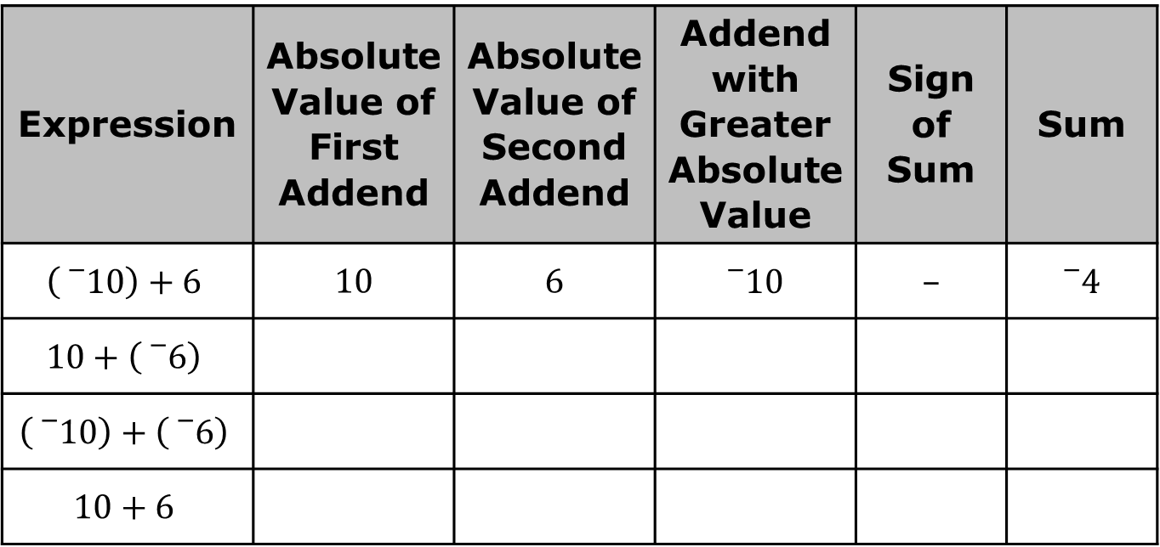
3.1.4 Refresher: Operations with Integers
Work with your partner to complete the table. The first addition expression has been done for you.
Expression | Absolute Value of First Addend | Absolute Value of Second Addend | Addend with Greater Absolute Value | Sign of Sum | Sum
$$\left({}_{}^{−}{10}\right)+6$$ | 10 | 6 | $${}_{}^{−}{10}$$ | – | $${}_{}^{−}4$$
$$10+\left({}_{}^{−}6\right)$$
$$\left({}_{}^{−}{10}\right)+\left({}_{}^{−}6\right)$$
$$10+6$$
volume 1, pg. 87

Slide 16
How did the size of the absolute value for each addend determine the sign of the sum?
Explain how finding the sum for the first two expressions was different from finding the sum for the last two expressions.
volume 1, pg. 87

Slide 17
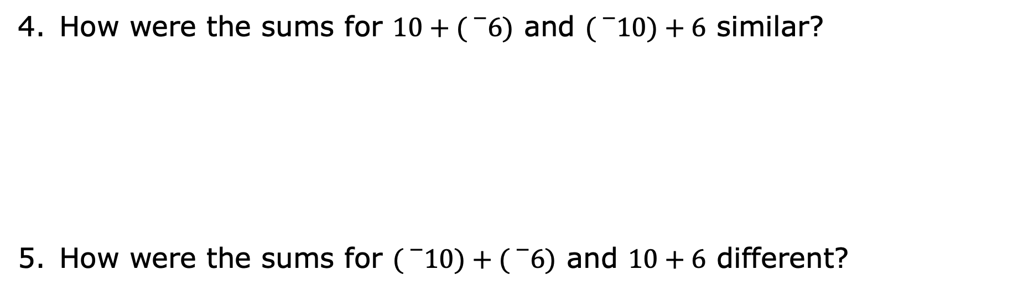
How were the sums for $10+({}_{}^{−}6)$ and $({}_{}^{−}{10})+6$ similar?
How were the sums for $({}_{}^{−}{10})+({}_{}^{−}6)$ and $10+6$ different?
volume 1, pg. 88

Slide 18
Complete the statements using the words same or different to describe the rules for finding the sums of signed numbers.
When two addends have the _____________ sign, the sum will have the sign of the addends.
When two addends have _____________ signs, the sum will have the sign of the addend with the greater absolute value.
volume 1, pg. 88

Slide 19
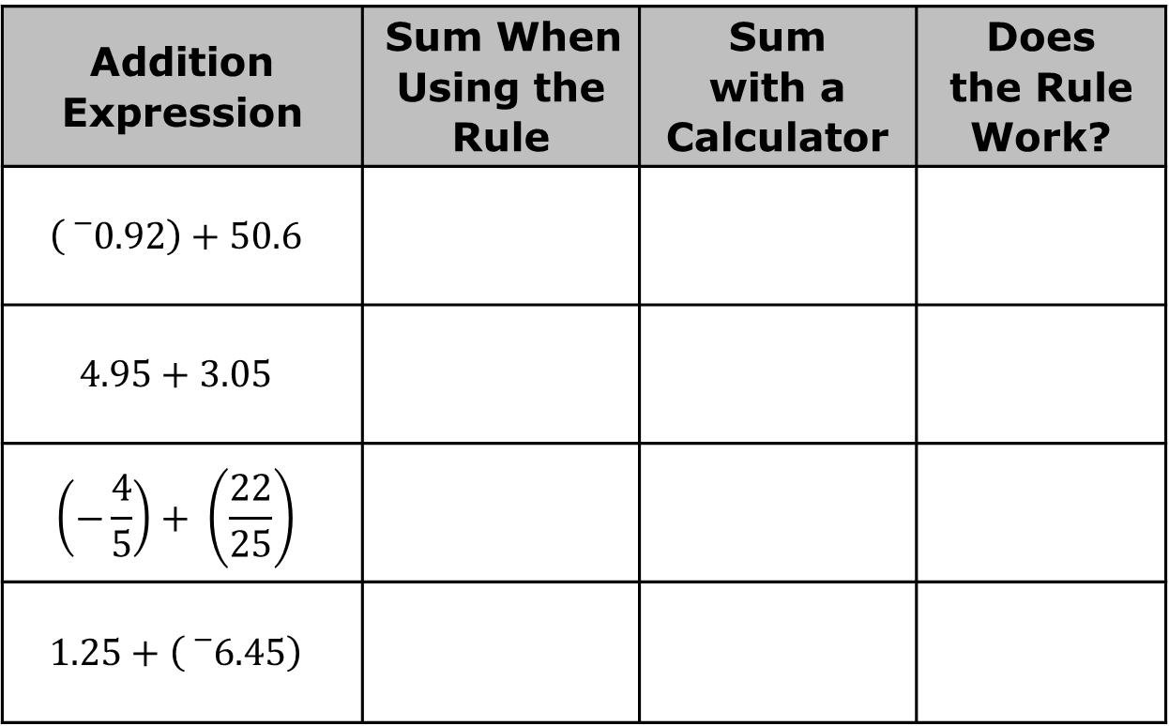
Apply the rules for integers to these expressions with rational numbers. Find the sum of each expression. Then, verify your answer using a calculator.
Addition Expression | Sum When Using the Rule | Sum with a Calculator | Does the Rule Work?
$$\left({}_{}^{−}{0.92}\right)+50.6$$
$$4.95+3.05$$
$$\left(−\frac{4}{5}\right)+ \left(\frac{22}{25}\right)$$
$$1.25+\left({}_{}^{−}{6.45}\right)$$
volume 1, pg. 88

Slide 20
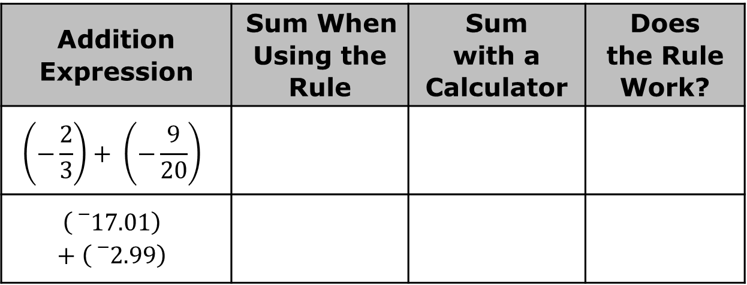
Addition Expression | Sum When Using the Rule | Sum with a Calculator | Does the Rule Work?
$$\left(−\frac{2}{3}\right)+ \left(−\frac{9}{20}\right)$$
$$\left({}_{}^{−}{17.01}\right)+\left({}_{}^{−}{2.99}\right)$$
Complete the sentence.
The sign rules for adding integers are as the rules for adding rational numbers.
the same
not the same
volume 1, pg. 88

Slide 21

Guided Practice
volume 1, pg. 89

Slide 22

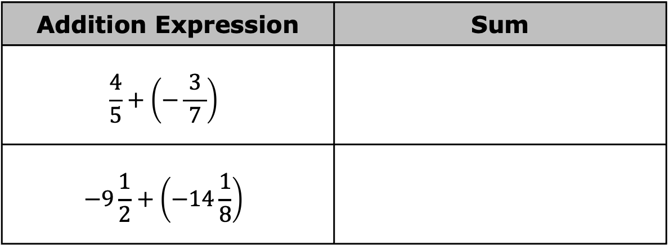
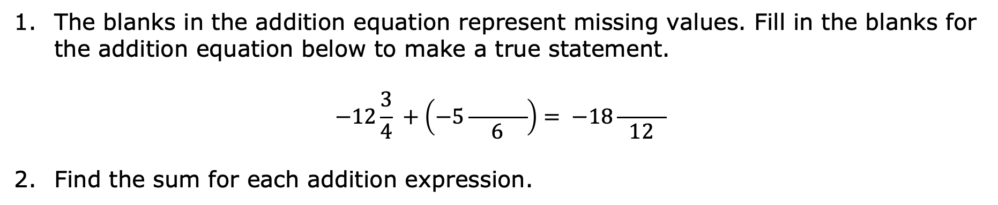
3.1.5 Guided Practice: Applying Signed Number Rules to Rational Numbers
The blanks in the addition equation represent missing values. Fill in the blanks for the addition equation below to make a true statement.
$$−12\frac{3}{4} +\left(−5\frac{ }{6}\right)= −18\frac{ }{12}$$
Find the sum for each addition expression.
Addition Expression | Sum
$$\frac{4}{5}+\left(−\frac{ 3 }{7}\right)$$
$$−9\frac{1}{2}+\left(−14\frac{1}{8}\right)$$
volume 1, pg. 89

Slide 23
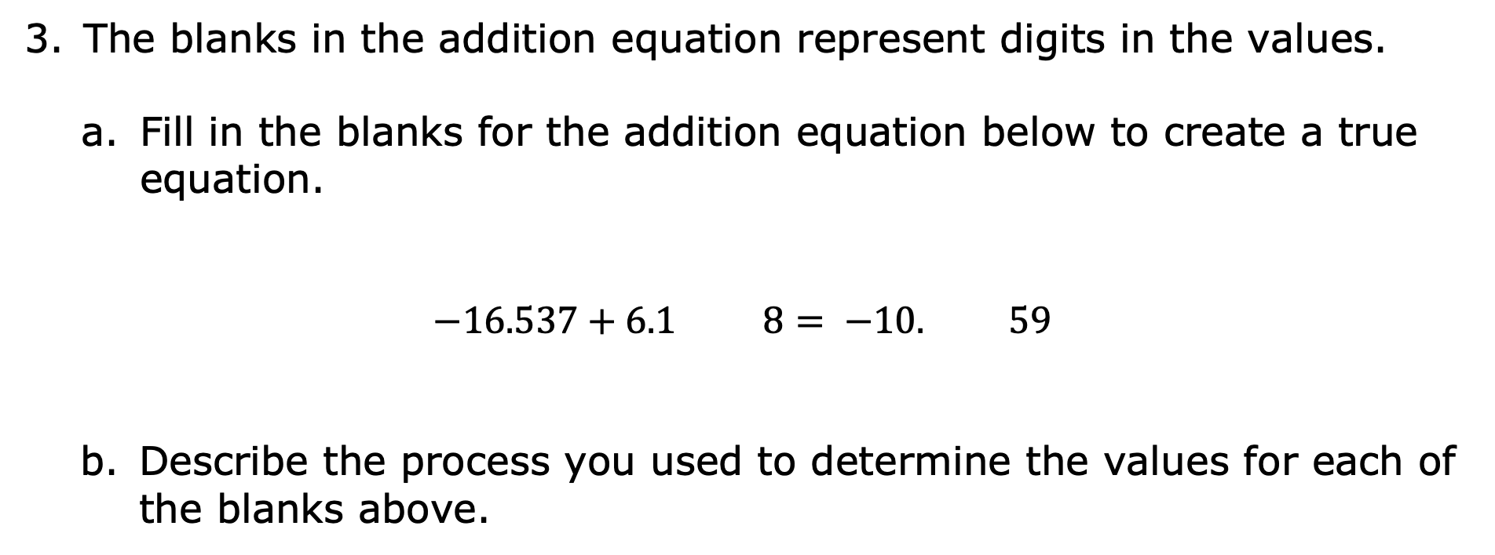
The blanks in the addition equation represent digits in the values.
Fill in the blanks for the addition equation below to create a true equation.
$$−16.537+6.1 8= −10. 59$$
Describe the process you used to determine the values for each of the blanks above.
volume 1, pg. 89

Slide 24
Discuss your process with your partner. Write a summary of their process. Have your partner initial to show that your summary accurately expressed their process.
Your Partner’s Process
Partner’s
Initials _____
volume 1, pg. 89

Slide 25

Your Turn
volume 1, pg. 90

Slide 26
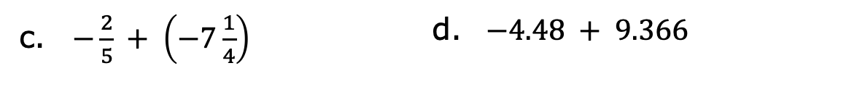
3.1.6 Your Turn!
Find the sum for each expression.
$−1\frac{1}{2} + \left(−\frac{1}{8}\right)$
$−12.37 + 18.161$
$−\frac{2}{5} + \left(−7\frac{1}{4}\right)$
$−4.48 + 9.366$
$−233.24 + 25.8$
$−4\frac{1}{7} + 17\frac{2}{9}$
volume 1, pg. 90

Slide 27

Wrap-Up
volume 1, pg. 90

Slide 28
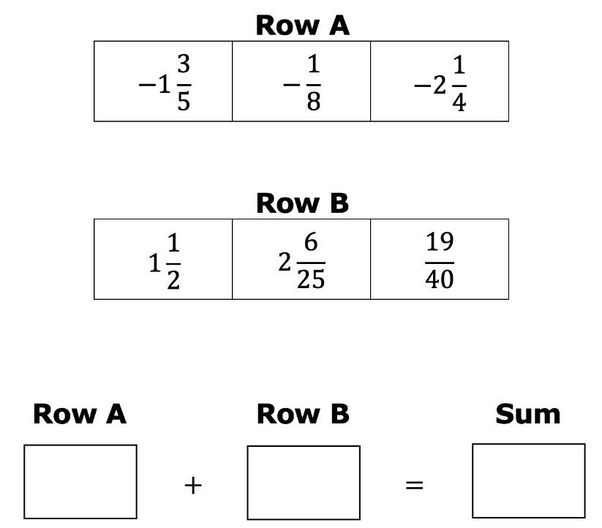
3.1.7 Wrap-Up: Ticket Out the Door
Choose a value from Row A and a value from Row B that, when added, will result in a negative answer. Then, calculate the sum.
volume 1, pg. 90

